Slide 1

Facebook
Presented By:-
Siddharth Mundhra
Nishanth Manjunatha
Rasagnya Reddy Avala
Minghao ru
Shirui Liu

Slide 2

Table of Content
Introduction
Statistical Features
ML Models
Random Forest
Trading Strategies
Other Findings
Conclusion

Slide 3
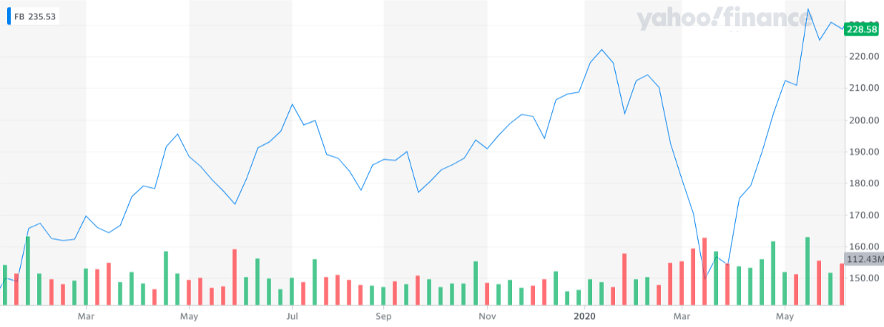



Facebook ($FB)
Founded in 2004
Went Public in 2012
Traded on NASDAQ: FB
Market Cap: $671.049B
Revenue: $73.36B
Acquisitions:

Slide 4
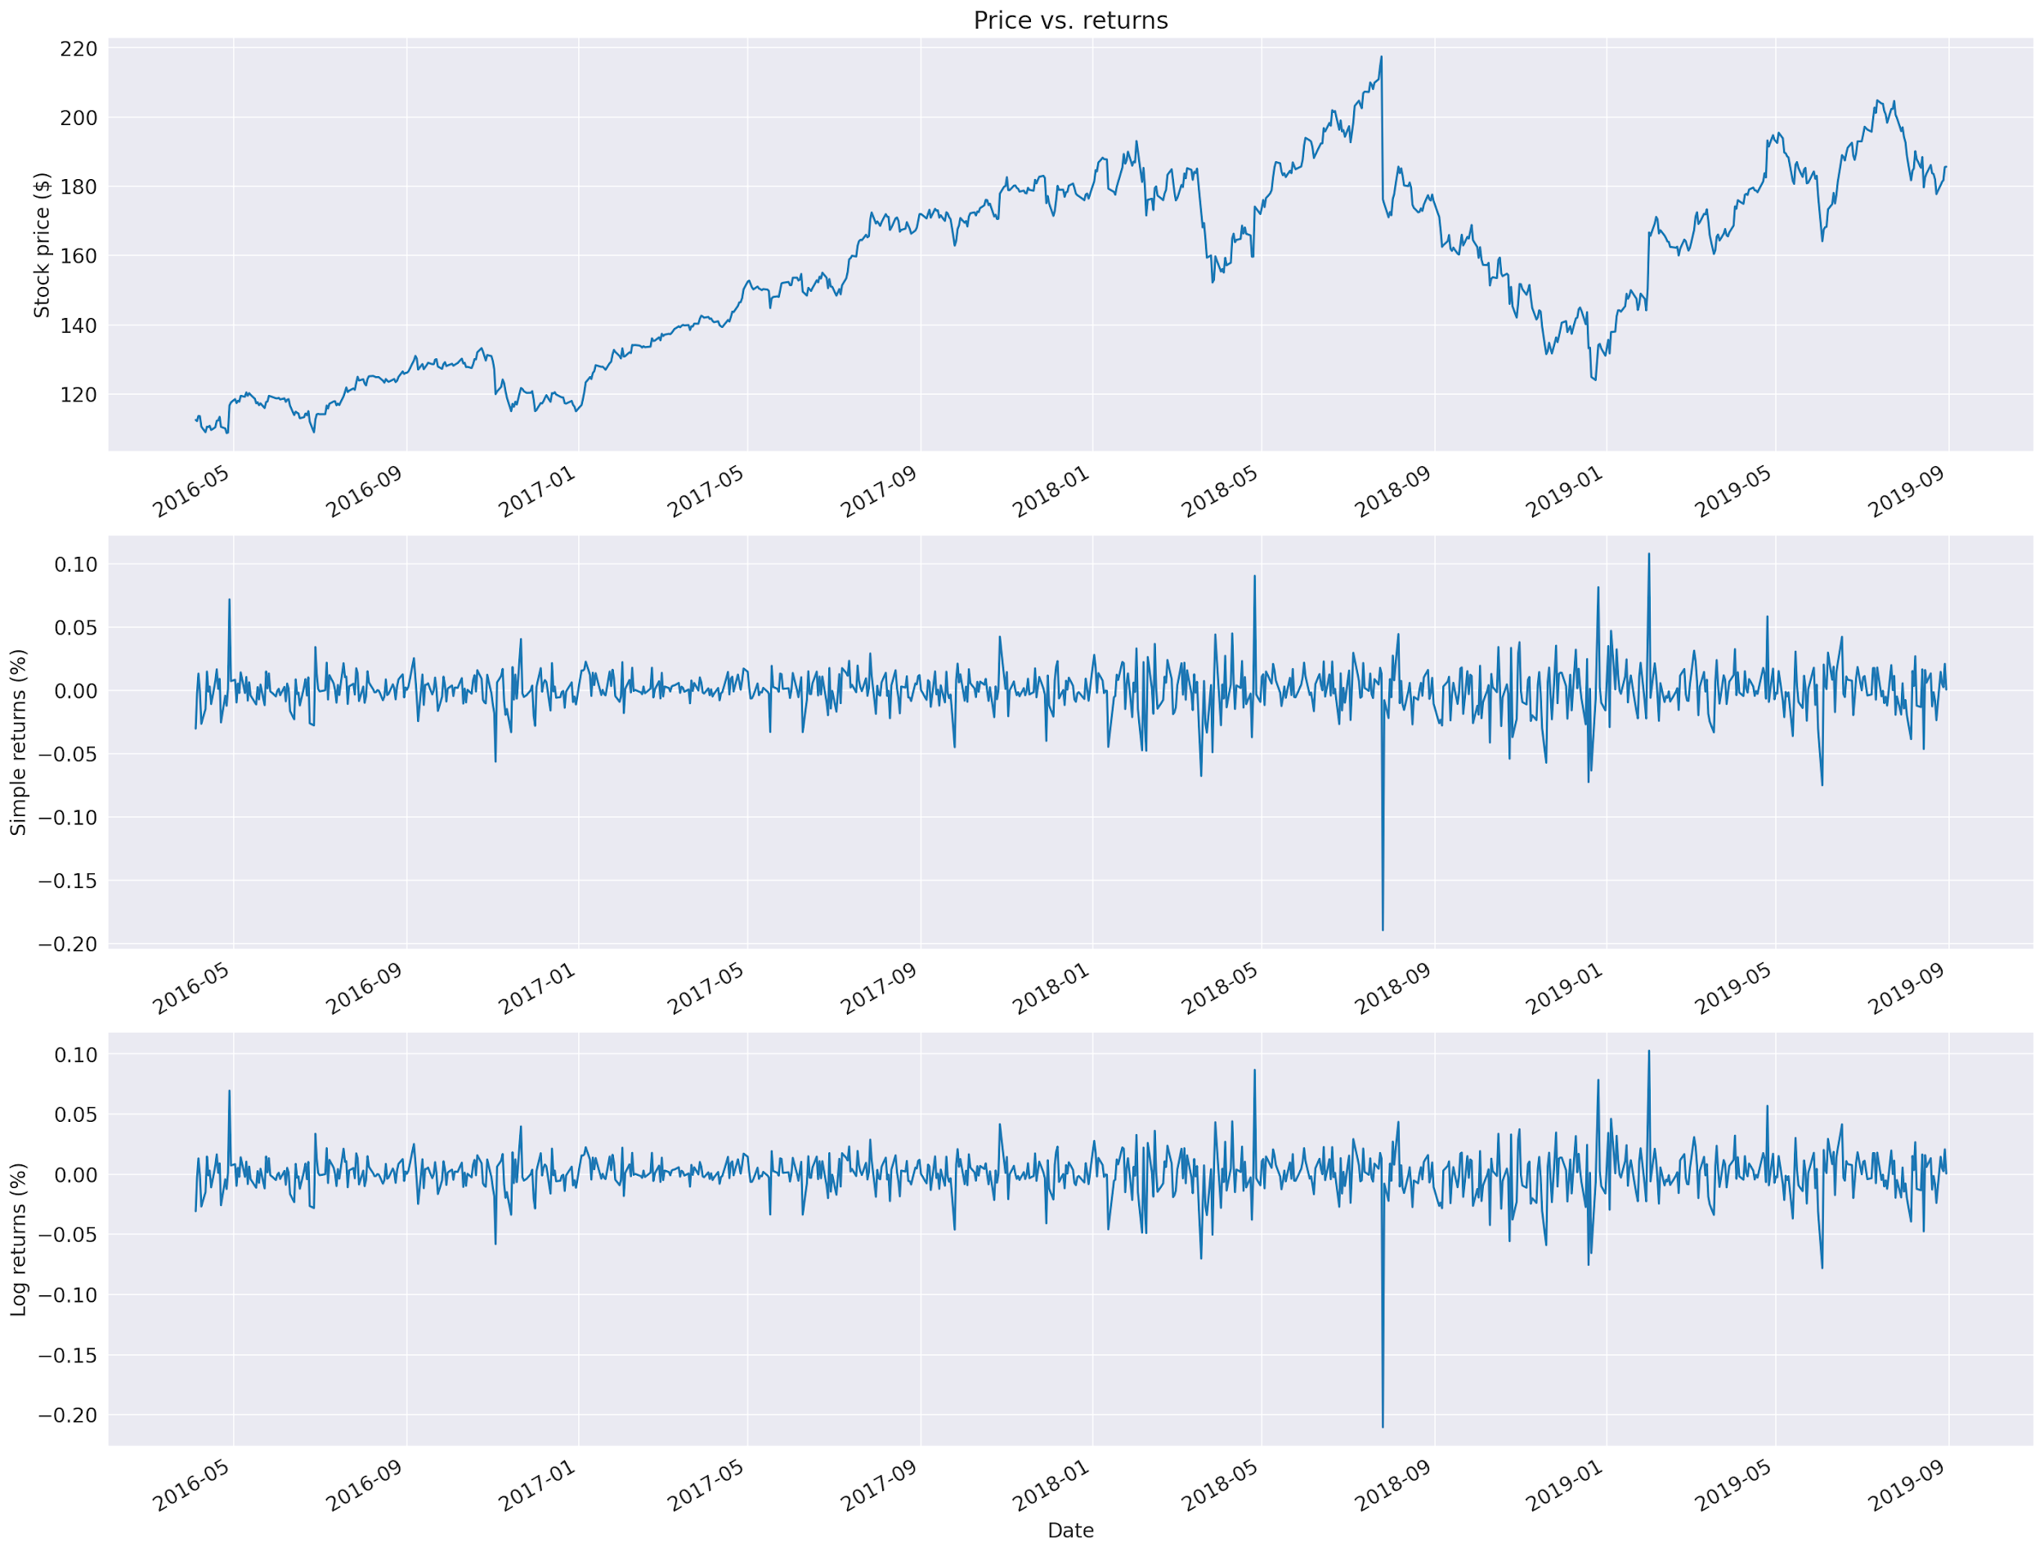
Statistical Features: Returns
Why work with returns? - To make the time series stationary, which is a desired property in statistical modeling
Formulae:
Simple Returns:
R_{t} = (P_{t} – P_{t-1}) / P_{t-1} = P_{t} / P_{t-1} – 1
Log Returns:
r_{t} = log(P_{t} / P_{t-1}) = log(P_{t}) – log(P_{t-1})
Where
P_{t} = price of the asset at time t.
We are defining the return from time t-1 to time t. The log function here is the natural logarithm.

Slide 5
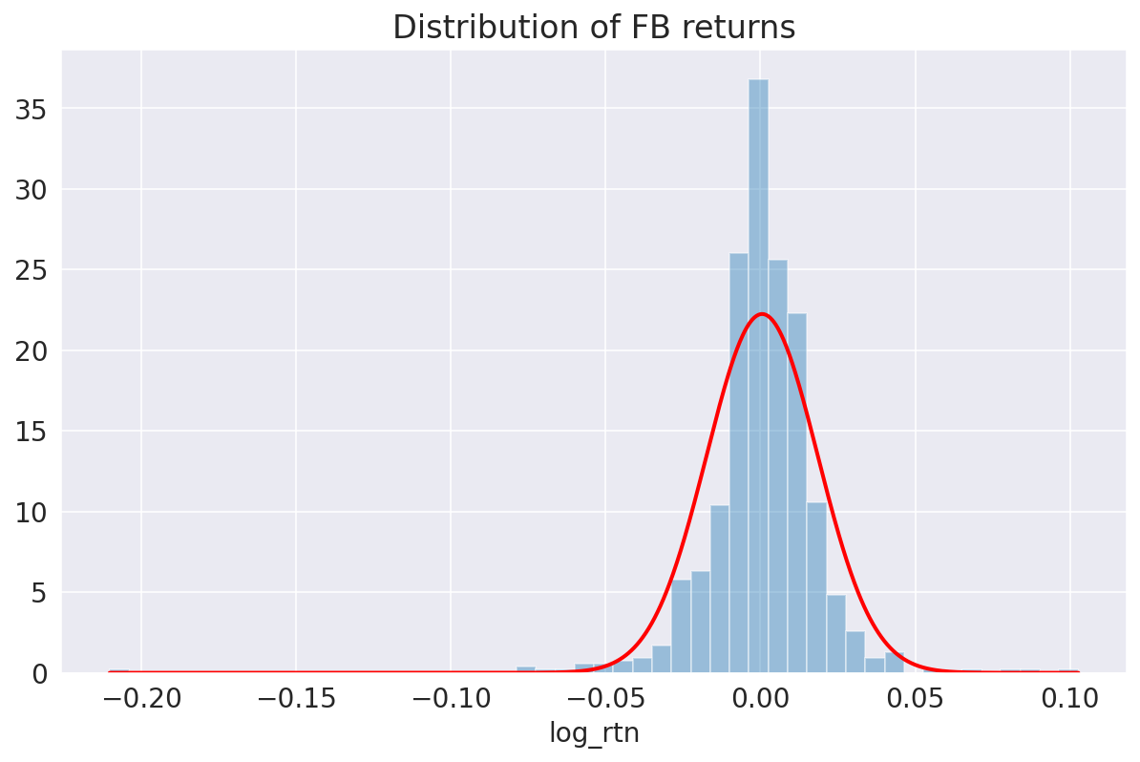
Statistical Features: Skewness and Kurtosis
In the case of $FB returns, it has been observed that returns exhibit:
Negative Skewness (third moment) — large negative returns occur more often than large positive ones. Visually: The left tail is longer; the mass of the distribution is concentrated on the right side of the distribution plot.
Excess Kurtosis (fourth moment) — large (and small) returns occur more often than expected. Visually: fat-tailed and peaked distribution.

Slide 6
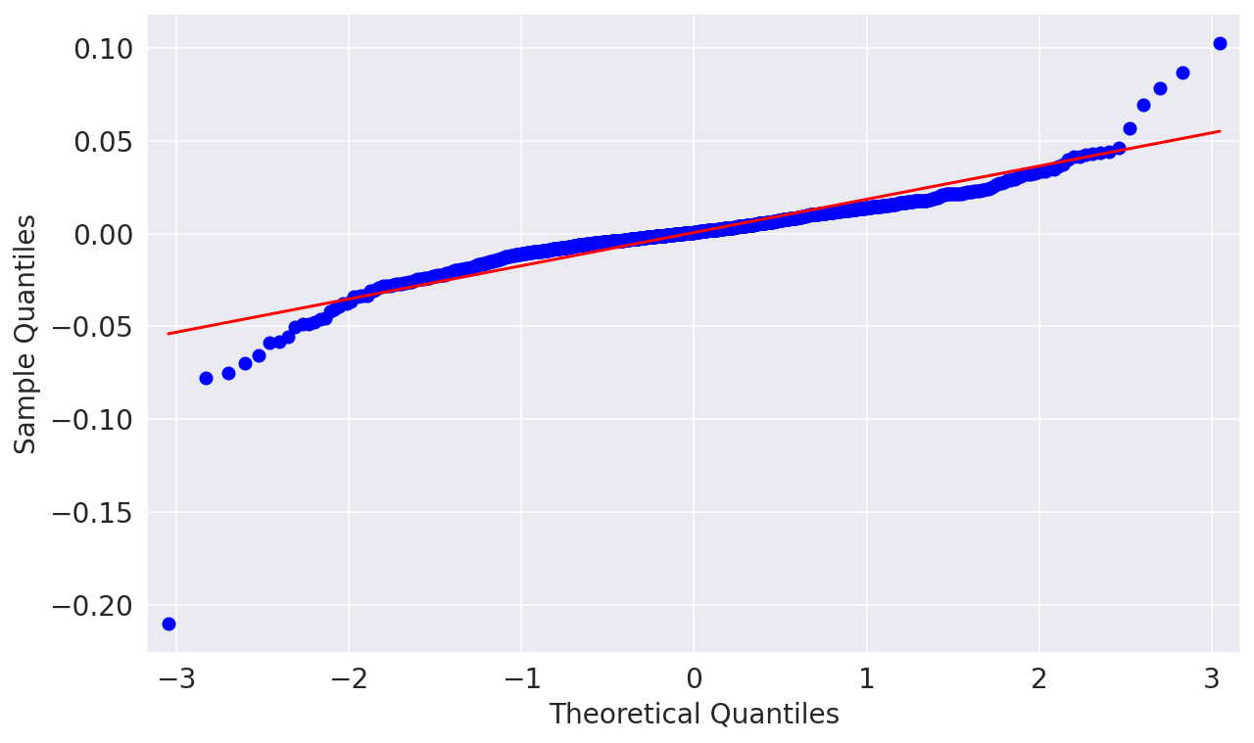
Statistical Features: Normal Distribution
The red line represents the Standard Normal distribution. In the case when the returns followed Gaussian distribution, those two lines would be aligned.
However, we see that there are differences, mostly in the tails. This further verifies that the returns are non-normal.

Slide 7
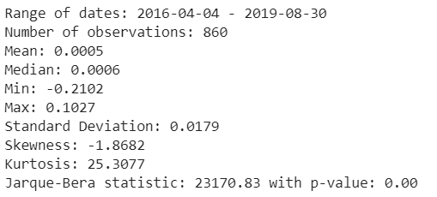
Statistical Features: Descriptive Statistics
The Jarque-Bera Normality Test confirms our suspicions, with p-value small enough to reject the null hypothesis stating that the data follows Normal distribution.

Slide 8
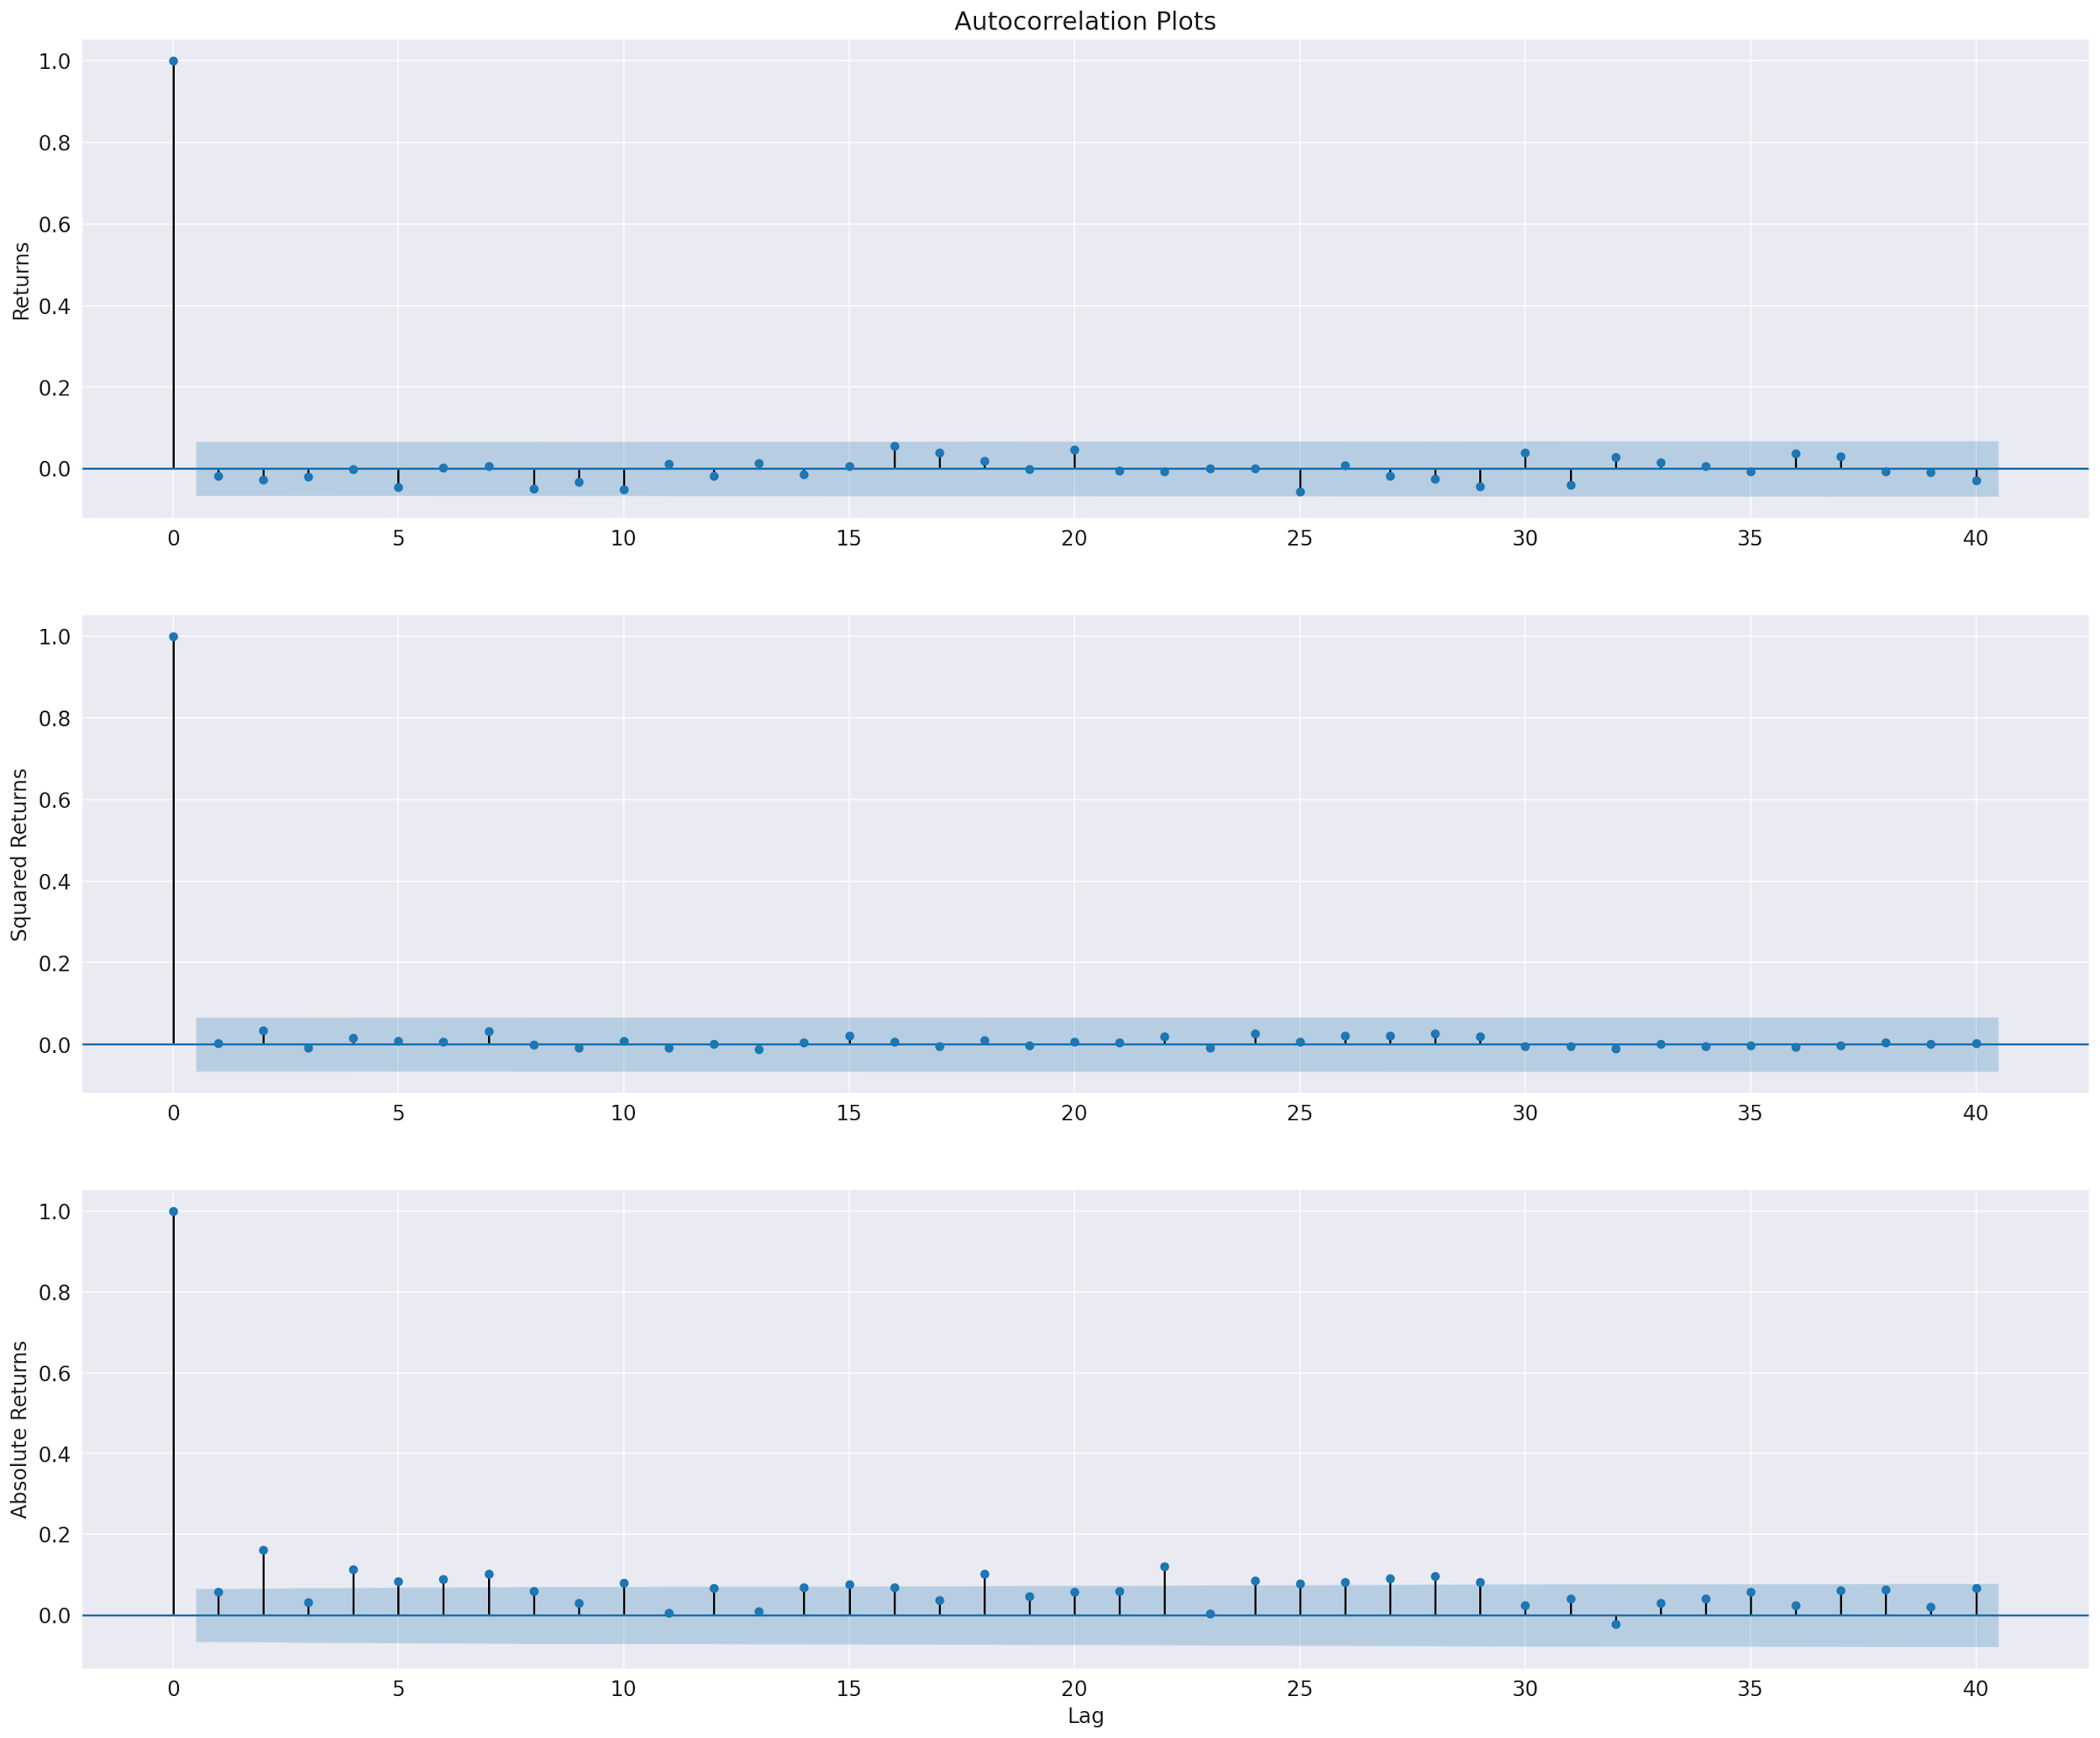
Statistical Features: Autocorrelation
The blue area indicates the 95% confidence interval, points outside of it are statistically significant. We see that for log returns, there are only a few significant points hence no significant autocorrelation.
Small and slowly decreasing autocorrelation is easier to observe for squared returns than in case of absolute returns.
Notes:
Autocorrelation measures the degree of similarity between a given time series and the lagged version of the same series over successive time intervals. It is analogous to the correlation between two time-series: the first one in its original form and one lagged by n periods.
By plotting the squared/absolute errors over time we could see whether the variance is constant over time. In case of asset returns, we can observe periods of high/low volatility aka ‘volatility clustering’ and can be observed at the time series plot of log returns.

Slide 9
Supervised Learning Models for Open Pricing
Kalman Filter
Linear Regression (EMA)
Fama French 3 Factor
SVM
Linear Regression (MACD)
GARCH

Slide 10
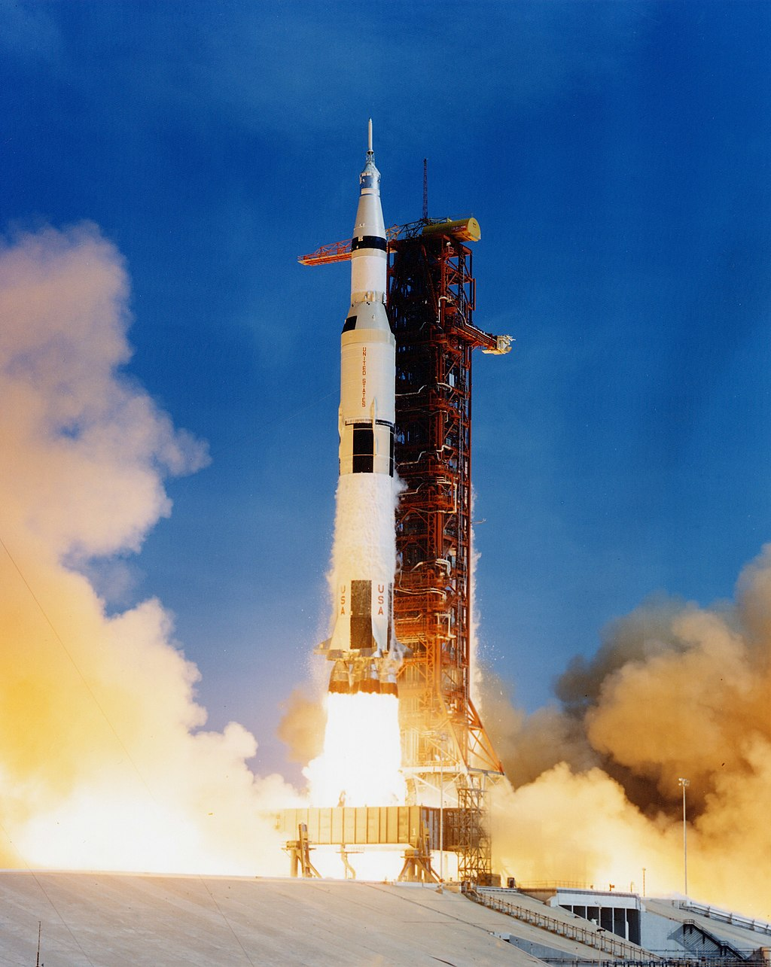
Kalman Filter
The kalman filter is an optimal estimation algorithm that uses noisy observations of a system over time to estimate the parameters of system and predict future observations.
The Kalman filter and state space models are strongly connected
The Kalman filter combines information sources to give better estimates.
Application: Navigation and control systems (Spaceships, Robots, touchpads), Trading strategies, Econometrics.

Slide 11
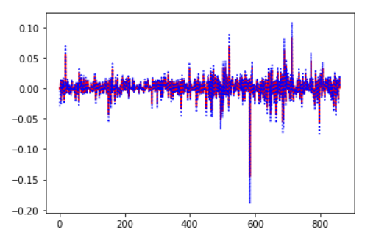
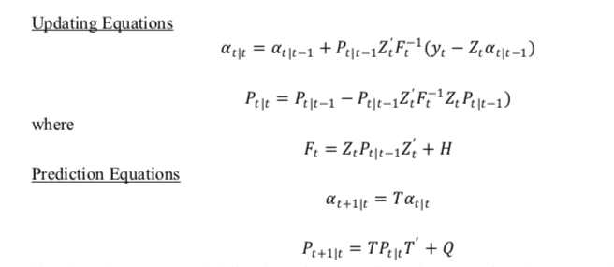

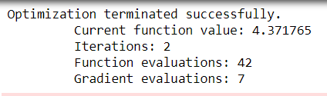
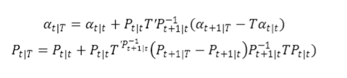
Kalman Filter
Smoother kalman filter
RMSE: 0.00426517197744397

Slide 12
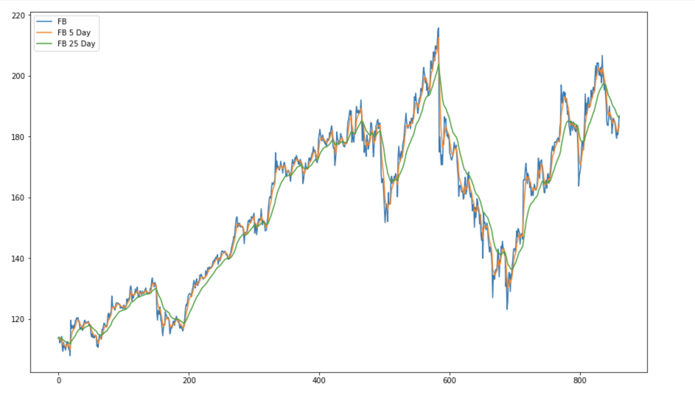
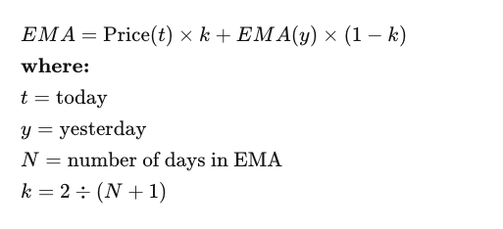
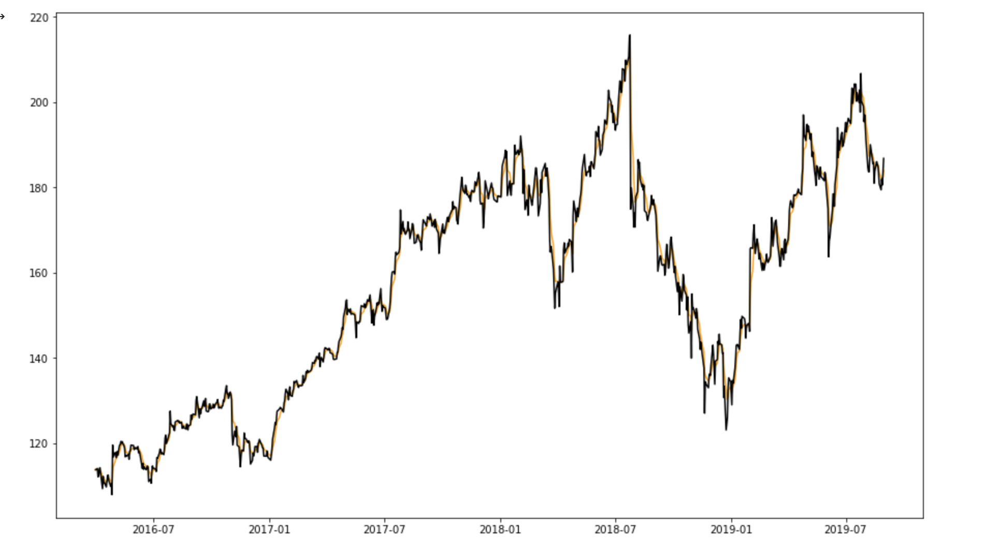
Linear Regression (EMA)
Exponential Moving Average
Moving averages that are calculated by assigning greater weights to more recent prices and proportionately lower weights to prices farther in the past and then averaging those together.
EMA using
pandas.df.ewm
Relation between EMA and Open values
RMSE : 5.05

Slide 13
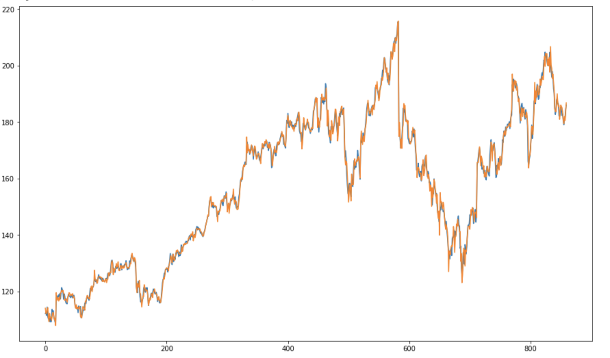
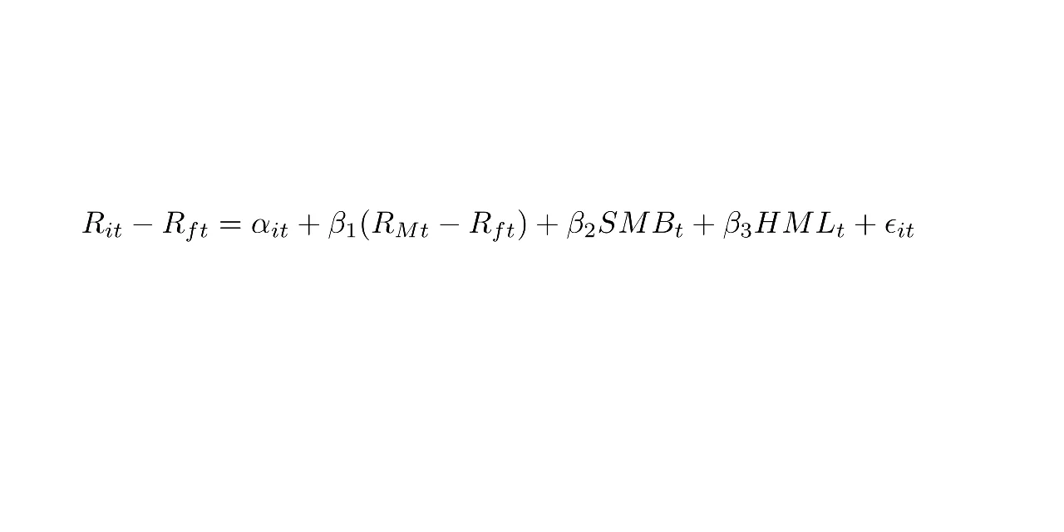
Fama French 3 Factor Model
The Fama French 3-factor model is an asset pricing model that expands on the capital asset pricing model by adding size risk and value risk factors to the market risk factors.
The model has three factors: size of firms, book-to-market values and excess return on the market.
For this model we used a combination of ADS Index and Fama/French 3 Factors [Daily] with FB data.
RMSE : 34.29

Slide 14
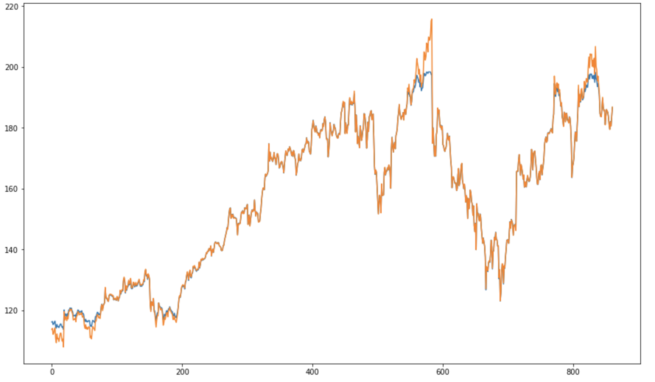
Support Vector Machine (SVM)
Support Vector Machine is a machine learning technique used in recent studies to forecast stock prices.
Support Vector Machines are one of the best binary classifiers. They create a decision boundary such that most points in one category fall on one side of the boundary while most points in the other category fall on the other side of the boundary.
RMSE: 7.280

Slide 15
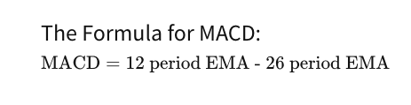
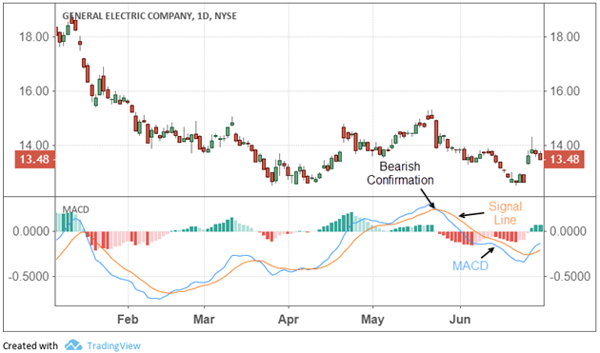
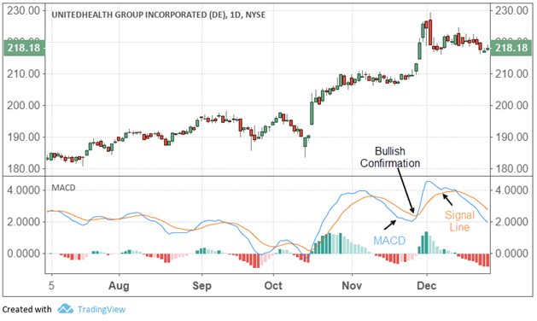
Moving Average Convergence Divergence (MACD)
MACD Line:
Signal Line:
nine-day EMA of the MACD
MACD falls below the signal line
MACD rises above the signal line
Time to Sell
Time to Buy

Slide 16
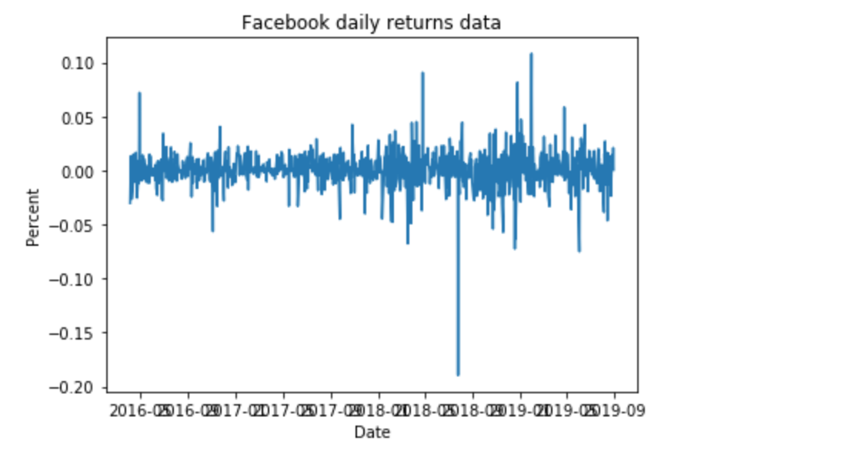
GARCH: Generalized Autoregressive Conditional Heteroskedasticity
Burst of Volatility
GARCH: Time series today is based on random error, time series yesterday and the volatility yesterday.
ARCH cannot give an appropriate prediction when the burst of volatility exists in a continued period of time, since it depends only one the random error and the time series yesterday. So we need another variable, the volatility yesterday, to help us get a more accurate prediction of time series today. That’s why we use Garch.

Slide 17
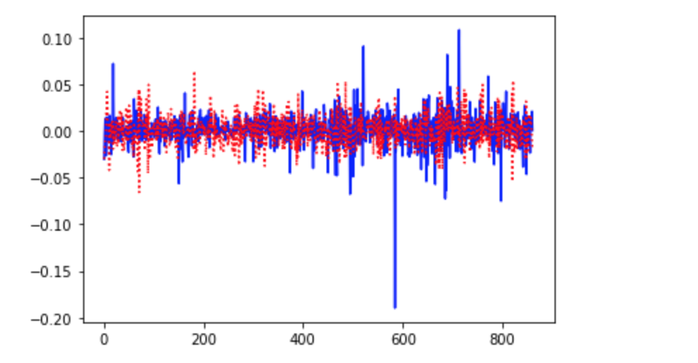
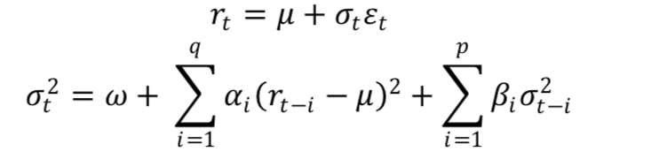
Garch: Generalized Autoregressive Conditional Heteroskedasticity
Parameters: [np.mean(Y),0.0001, 0.2, 0.5]
RMSE: 0.0243994528256253

Slide 18
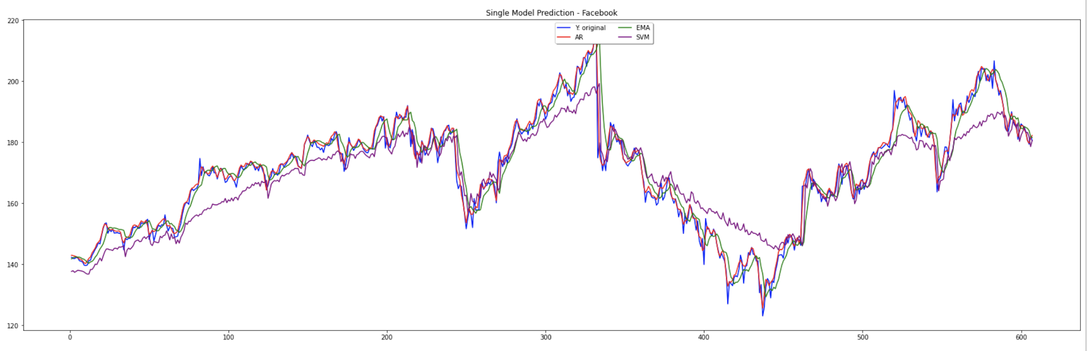
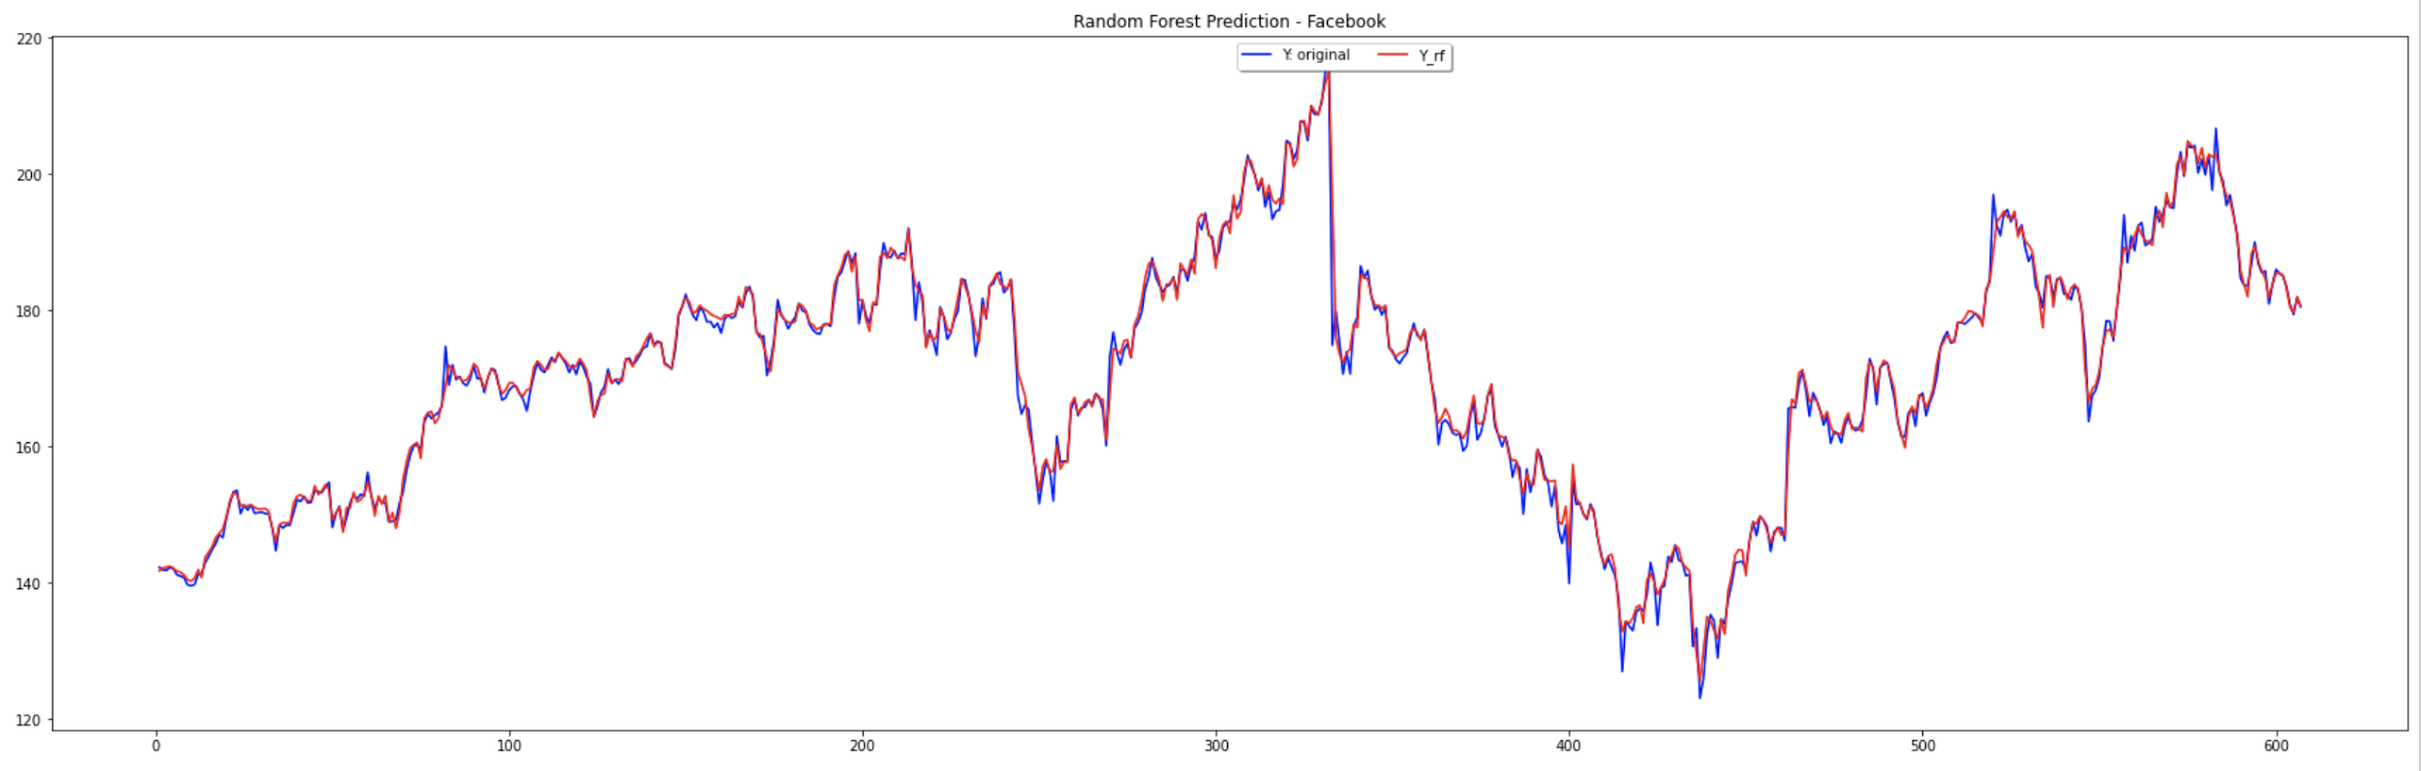
Random Forest
Consists of a large number of individual decision trees that operate as an ensemble
A large number of relatively uncorrelated models (trees) operating as a committee will outperform any of the individual constituent models
AR_RMSE: 1.9076290240331346
EMA_RMSE: 5.050240539306411
MACD_RMSE: 5.1444098494264665
SVM_RMSE: 7.280697329212049
Random forest RMSE: 1.6211889048736239

Slide 19
Trading Strategies
EMA and MACD Signal Crossovers
Buy Sell Hold
Bollinger Band

Slide 20
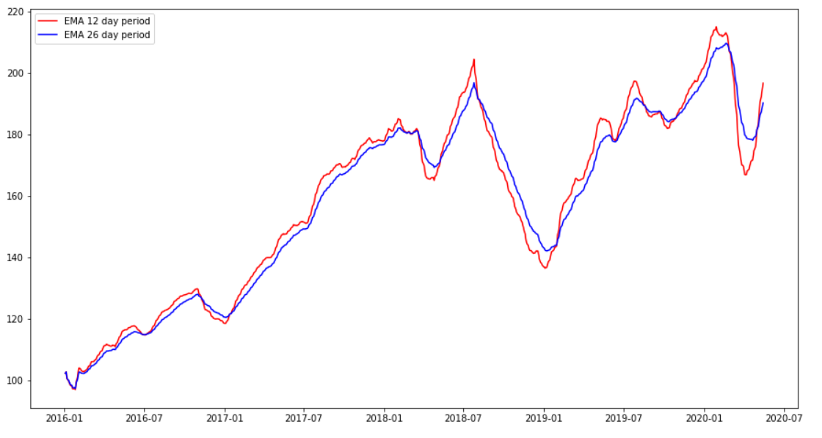
EMA Crossover

Slide 21
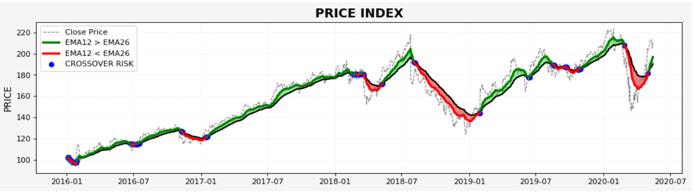
Trading Strategies - Crossover

Slide 22
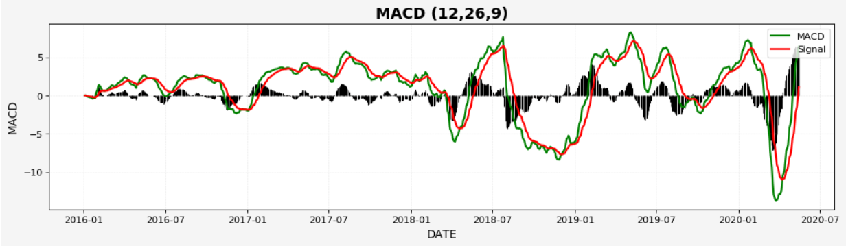
Buy Sell & Hold - MACD Signal Crossovers
MACD formula: MACD = 12 Day period EMA - 26 Day period EMA
The MACD has a positive value whenever the 12-period EMA is above the 26-period EMA
The MACD has a negative value whenever the 12-period EMA is below the 26-period EMA
A 9-day EMA of MACD called "signal line" is plotted on top of the MACD line.
·

Slide 23
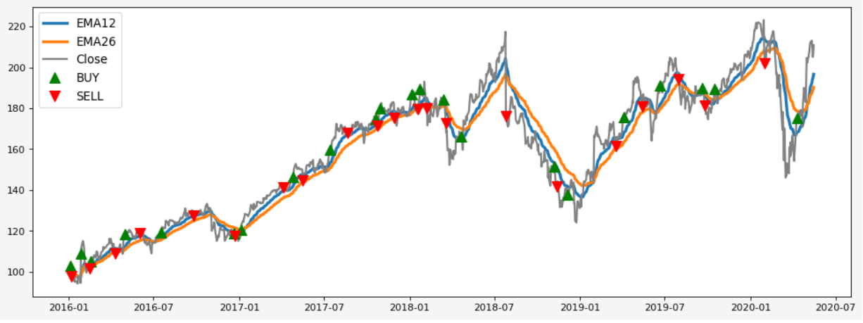
Buy and Sell

Slide 24
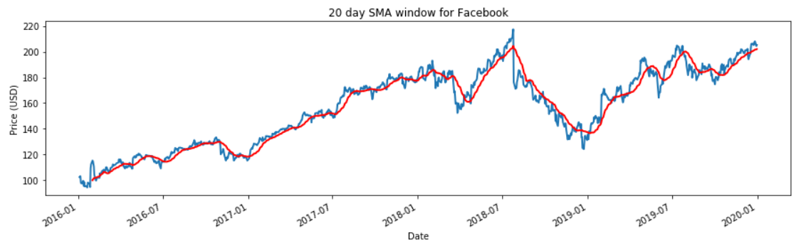
Simple Moving Average (SMA)

Slide 25
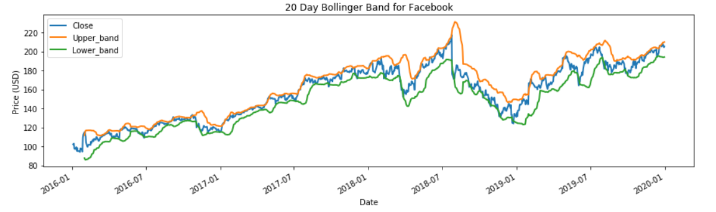
Bollinger Band

Slide 26
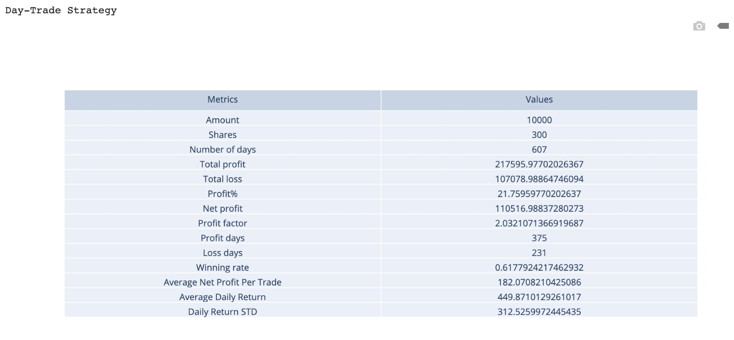
Day Trade using Random Forest

Slide 27
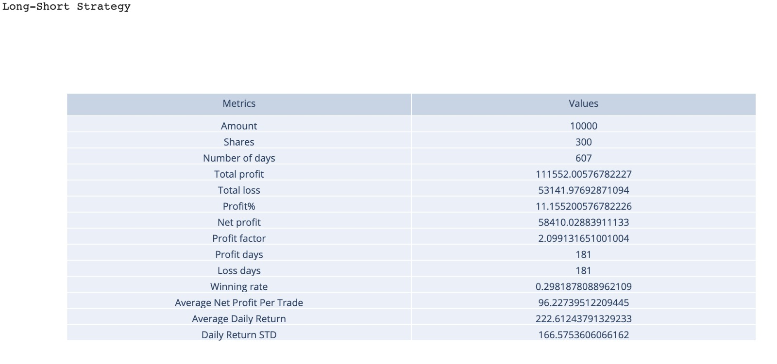
Long Short using Random Forest

Slide 28
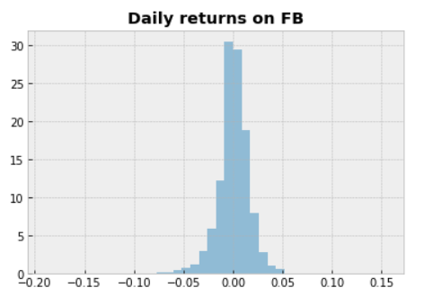
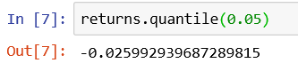
Value at Risk using Historical Bootstrap
The 0.05 empirical quantile of daily returns is at -0.025. That means that with 95% confidence, our worst daily loss will not exceed 2.5%. If we have a $1M investment, our one-day 5% VaR is 0.025 * $1M = $25k.

Slide 29
Other Findings
PCA
ARIMA
Ridge
Lasso

Slide 30
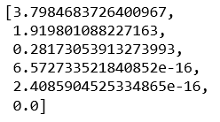
Principal Component Analysis - Dimensionality Reduction Technique
PCA Scores
Important Features
Close
High
Volume
Low

Slide 31
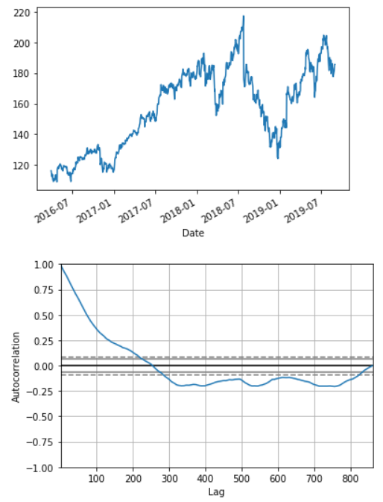
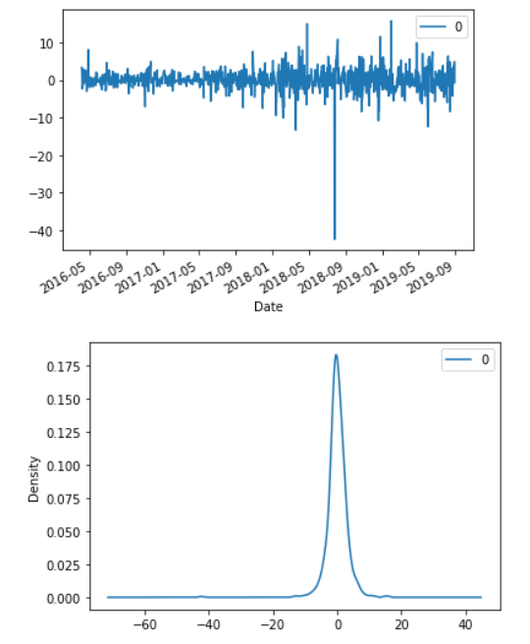
ARIMA

Slide 32
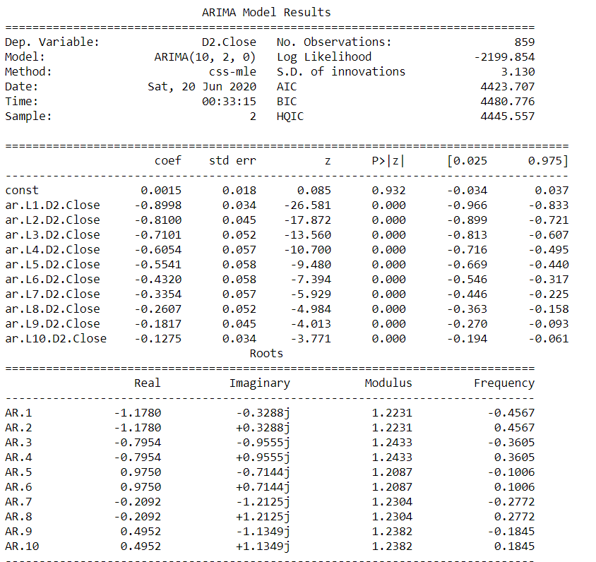
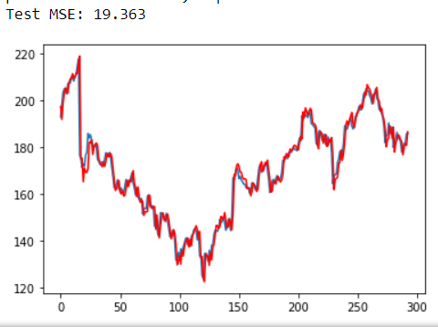
Predictions

Slide 33
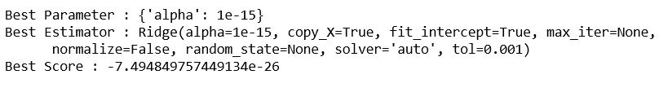
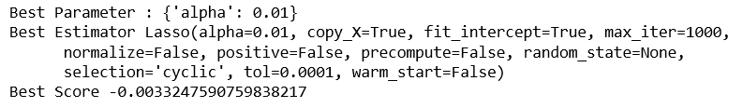
Ridge
Lasso

Slide 34
Conclusion
Model RMSE: 1.6211
Invest Money: 10000
Number of Shares: 300
Day Trade Net Profit: 110516
Long Short Net Profit: 58410
Number of Days: 607

Slide 35
Thank You

Slide 36
References
https://www.investopedia.com/terms/m/macd.asp
https://en.wikipedia.org/wiki/Bootstrap_model

